Slide 1
Detecting Idiographic Personality Change
Emorie D Beck
Joshua J Jackson
Washington University in St. Louis
Preregistration: https://osf.io/mfn8w/ Script, data, and results: github.com/emoriebeck/KCP

Slide 2
The Big 5
Extraversion
Agreeableness
Conscientiousness
Neuroticism
Openness
Direction
Magnitude
--
.6 SD
1 SD
-.8 SD
.4 SD
Timing
--
Lifespan
Lifespan
10-35
10-20
Roberts, Walton, & Viechtbauer, 2006
Notes:
Within psychology and the study of personality, the big 5, E, A, C, N, O, have become ubiquitous.
Not only do they reliably predict a number of outcomes, but they also show reliable patterns of change and development in the direction, magnitude, and timing of change.
But the observation of normative change raises the question of

Slide 3
WHY?
Notes:
WHY it shows these normative changes

Slide 4
Birth of Child
Separated from Partner
Child Leaves Home
Death of Partner/Spouse
Marriage
Divorced
Leaving Parental Home
Moved in with Partner
First Job
Death of Parent
Retirement
Unemployment
E
X
X
X
X
X
X
✓
X
X
X
X
X
A
X
X
X
✓
X
X
X
X
X
X
X
X
C
X
X
X
X
X
X
X
X
X
X
X
X
N
X
X
X
X
X
X
X
X
X
X
X
X
O
X
X
X
X
X
X
X
X
X
X
X
X
Beck, Specht, Bleidorn, & Jackson (2019)
Notes:
One area of study on this question has aksed whether life events that people experience might be associated with patterns of personality development and change.
In a recent study, I looked at 12 different life events and their reliationship to trends

Slide 5
Problems with
Mean-Level Change
Timing
Level of Analysis
Independence of Traits
Notes:
But there a few key issues with mean-level change that suggest that we might need to ask questions about the relationship between personality change life events differently

Slide 6
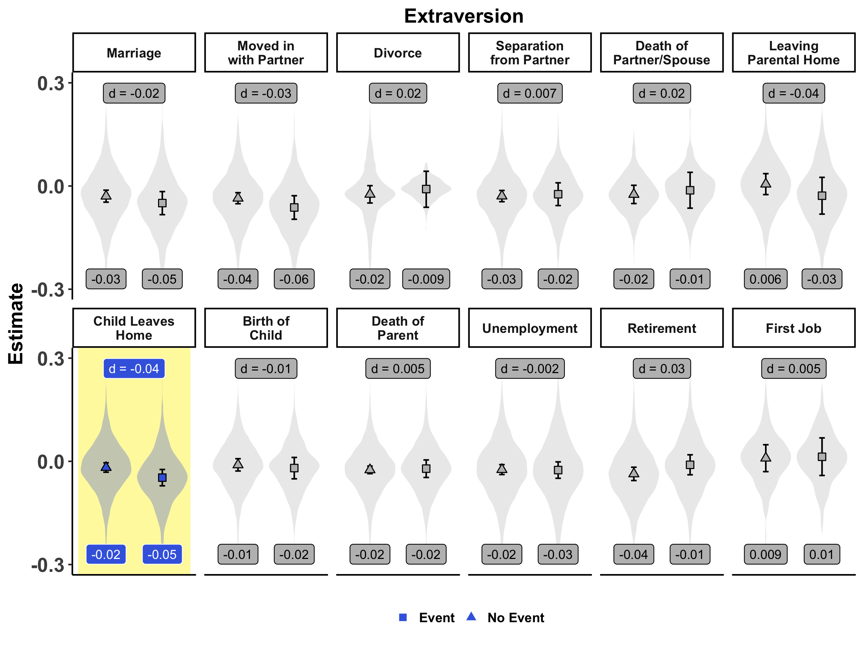
Notes:
And large individual differences in change suggest that there are people who show change after experiencing an event and that the direction of that change is almost as variable as the magnitude

Slide 7
“Tipping Points”
Close to Transition
chronic
Loss of Functioning
recovery
delayed
Far from Transition
resilience
Time
Bonanno, 2004; van Leemput et al., 2014; Cramer et al., 2016; Cabrieto et al., 2018
Notes:
Timing of change

Slide 8
“Tipping Points”
chronic
Loss of Functioning
recovery
delayed
resilience
Time
Bonanno, 2004
Notes:
Timing of change

Slide 9
Timing of Change
Schwaba & Bleidorn, 2017; Doss et al., 2009 ; Bleidorn et al., 2016
Notes:
For timing, when we consider mean-level change, we typically mean linear change, where no change would be indicated by a horizontal line and mean-level change would be indicated by lines with positive or negative slopes
However, this assumes that change surrounding an event is linear, when in fact there are a number of non-linear trajectories we may expect.

Slide 10
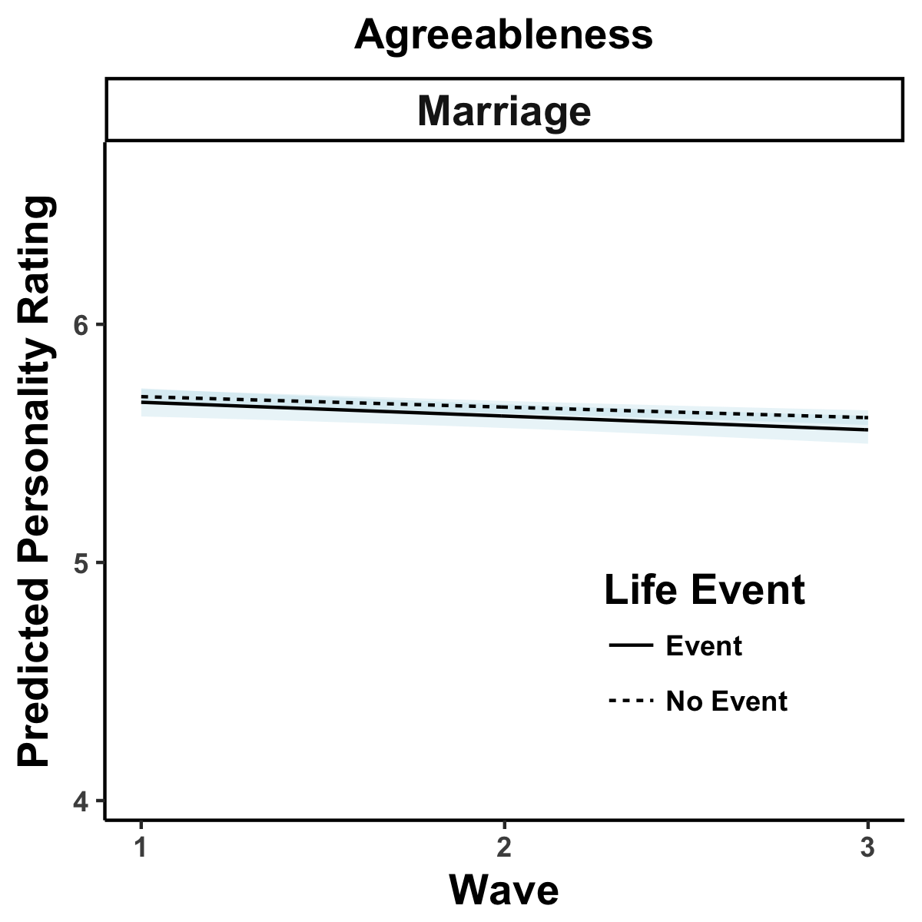
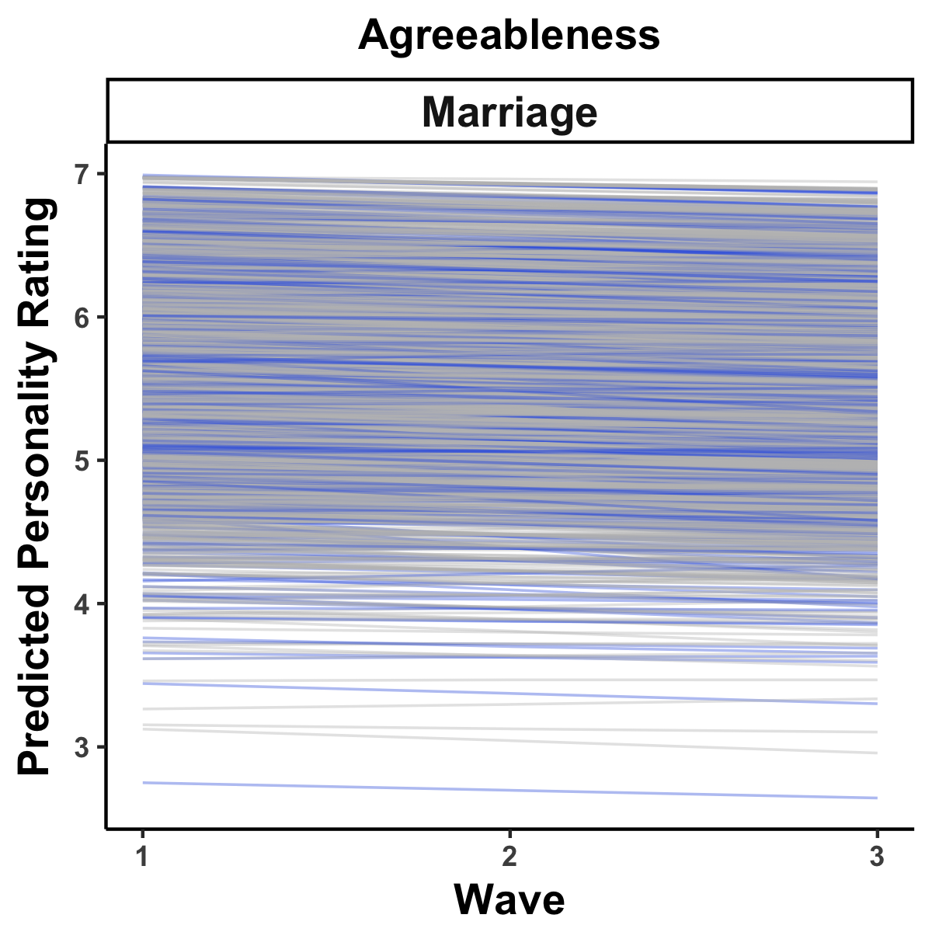
Level of Analysis
Notes:
Moreover, an important aspect of mean-level change is that it is average change across samples. But there are also individual differences in level and change, with many people who did or did not experience an event showing similar patterns fo change, suggesting that the individual may be the ideal level of analysis for assessing intraindividual change.

Slide 11
“No trait operates alone”
Allport, 1937, p. 330
Extraversion
Agreeableness
Conscientiousness
Neuroticism
Openness
“Personality is the dynamic organization within the individual of those psychophysical systems that determine his unique adjustments to his environment”
Notes:
Finally, Gordon Allport wrote in 1937 that “No trait operates alone.” But when we examine mean level change, we typically look at independent trait-level trajectories.
But Allport and others as you’ve seen today, suggested that this is overly simplistic. In fact, Allport defined personality as

Slide 12
An Idiographic Personality Systems Approach
Extraversion
Conscientiousness
Agreeableness
Neuroticism
Openness
Notes:
Instead, if we proceed from an individual, idiographic systems approach, we might view personality as consistent relationships among the manifestations of personality traits within a person over time. And those relationships might indicate the susceptibility of the personality change reliable changes that are reflected in the manifestation of personality.
So here, for example, if these lines represent the relationships between time series personality data for a single person and the thickness represents the strengths, boosts or dips in a Conscientiousness are unlikely to grealy influence the manifestation of other personality charactersitics
Analagous to a set of dominoes, if the Conscientiousness domino tips over, the overall system is unlikely to be affected

Slide 13
An Idiographic Personality Systems Approach
Extraversion
Conscientiousness
Agreeableness
Neuroticism
Openness

Slide 14
An Idiographic Personality Systems Approach
Extraversion
Extraversion
Conscientiousness
Agreeableness
Conscientiousness
Agreeableness
Neuroticism
Openness
Neuroticism
Openness
Notes:
However, if over time, this individual starts exhibiting more and stronger relationships between the manifestation of personality, this may result in changes within the system. Here, boosts and dips in Conscientious might influence Neuroticism, which in turn influences Agreeableness that influences Extraversion and so on.

Slide 15
An Idiographic Personality Systems Approach
Extraversion
Extraversion
Conscientiousness
Agreeableness
Conscientiousness
Agreeableness
Neuroticism
Openness
Neuroticism
Openness
Notes:
Thus, if the Conscientiousness domino tips over,

Slide 16
An Idiographic Personality Systems Approach
Extraversion
Extraversion
Conscientiousness
Agreeableness
Conscientiousness
Agreeableness
Neuroticism
Openness
Neuroticism
Openness
Notes:
this may result in system wide changes
But how do we detect if there are reliable changes in a personality system that may influence the manifestation of personality in everyday life

Slide 17

Notes:
A recent paper in nature proposed a permutation based kernel change point procedure for detecting reliable correlational changes in a psychological system.

Slide 18
E | Extraverted, enthusiastic
 | Reserved, quiet (-)
A | Critical, quarrelsome (-)
 | Sympathetic, warm
C | Dependable, self-disciplined
 | Disorganized, careless (-)
N | Anxious, easily upset
 | Calm, emotionally stable (-)
O | Open to new experiences, complex
 | Conventional, uncreative (-)
N = 388 participants (total N = 21,790)
60 possible assessments
Personality
Baseline
60 weeks
Death of a Family Member
Partner Traveled
Became Pregnant
Became Engaged
Moved in with Partner
Got Married
Broke up with Partner
Life Events
Preregistration: https://osf.io/mfn8w/
Notes:
Before we dive into the procedure, let me tell you about the data we are using to test it.
These data came from a longitudinal study at the University of Illinois Urbana Champaigne in which 388 participants in romantic relationships responding to a series of surveys for up to one year. Among other measures like attachment, participants reported on their personality and life events they experienced. Persoanlity was measured using the TIPI. We will use composites of these measures as the data we had access to had already been composited. We used data for seven life events, including the death of a family member, moving in with a partner, or breaking up with a partner.
This study was preregistered and the preregistration is available at the link below.

Slide 19
Notes:
The procedure is quite complex

Slide 20
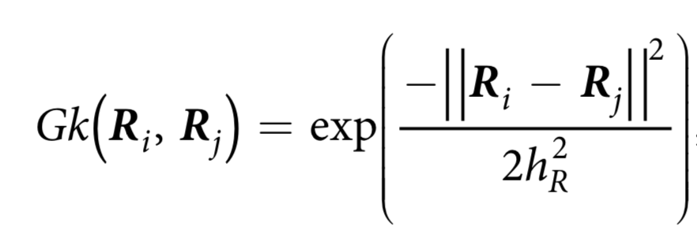
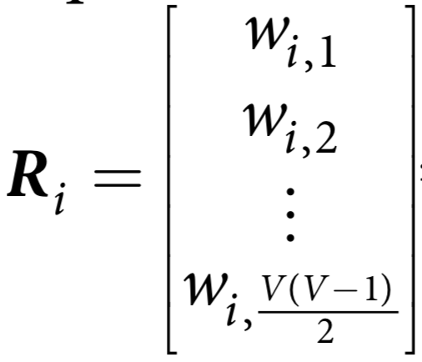
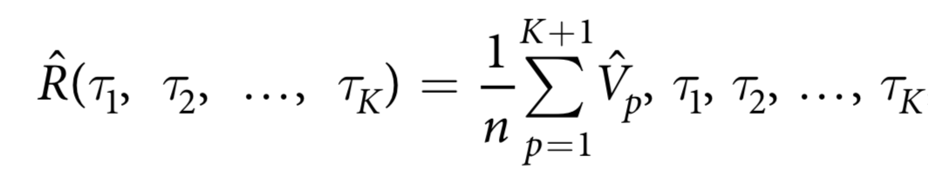
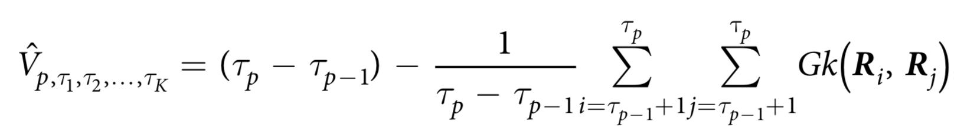
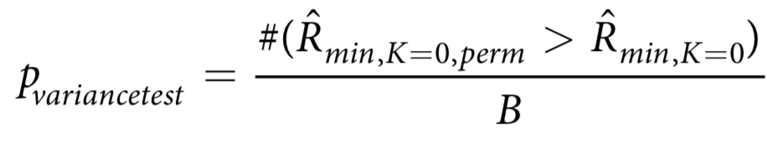
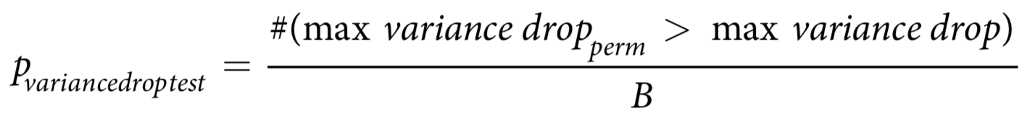
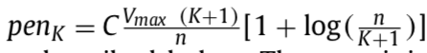
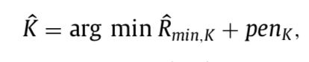
1
Moving Window Correlations
Gaussian Similarity between all
possible phases for different k
2
3
Calculate average within-phase
Variance of Gaussian Similarity
Repeat steps 1 and 2 for 1000
permuted data sets
4
Perform the variance test
5
Perform the variance drop test
6
Declare significance if either the
variance or variance drop tests passes
7
Keep k of minimum penalized
average within-phase variance
8
Preregistration: https://osf.io/mfn8w/
Notes:
Not going to get into the details, but basically, the KCP procedure is going to leverage the gaussian similarity between the correlations of different windows to test whether the variance of those correlations between two points is greater than what we would expect if the time series was randomly ordered.

Slide 21
1
Moving Window Correlations
Gaussian Similarity between all
possible phases for different k
2
3
Calculate average within-phase
Variance of Gaussian Similarity
Repeat steps 1 and 2 for 1000
permuted data sets
4
Perform the variance test
5
Perform the variance drop test
6
Declare significance if either the
variance or variance drop tests passes
7
Keep k of minimum penalized
average within-phase variance
8
Preregistration: https://osf.io/mfn8w/
Notes:
But the two steps I want to make sure you understand involve moving window correlations and permutations

Slide 22
1
Moving Window Correlations
Gaussian Similarity between all
possible phases for different k
2
3
Calculate average within-phase
Variance of Gaussian Similarity
Repeat steps 1 and 2 for 1000
permuted data sets
4
Perform the variance test
5
Perform the variance drop test
6
Declare significance if either the
variance or variance drop tests passes
7
Keep k of minimum penalized
average within-phase variance
8
Preregistration: https://osf.io/mfn8w/

Slide 23
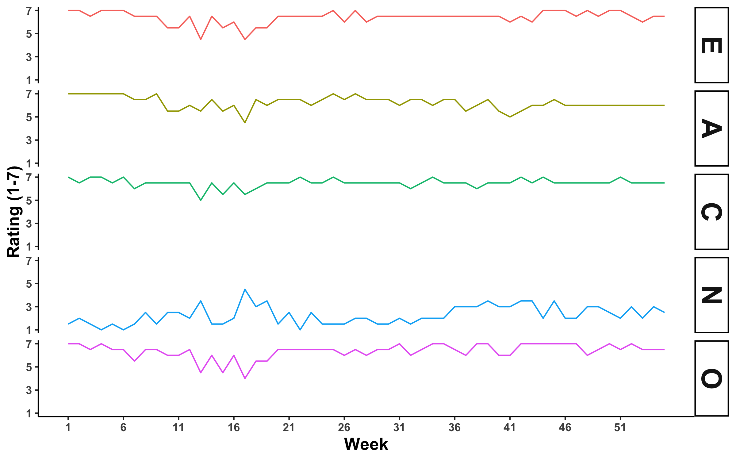
Idiographic Time Series
Notes:
Before we get to moving window correlations, we have to understand multivariate time series. Basically, we have multiple times series measured over time. Here we have time on the x axis, ratings on the y axis and the measures for different traits as different lines

Slide 24
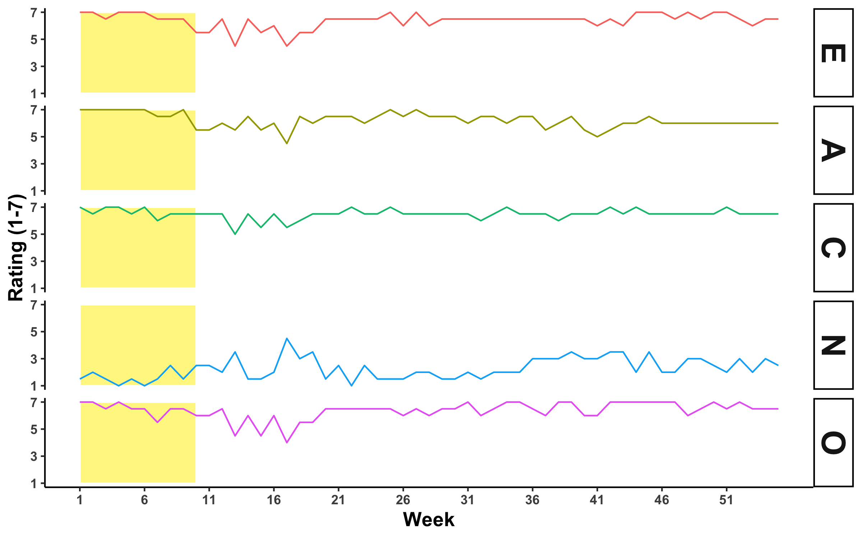
Idiographic Time Series
Notes:
In moving window correlations, we basically put a window at the beginning of the time series and calculate the correlation among the personality measures within the window.

Slide 25
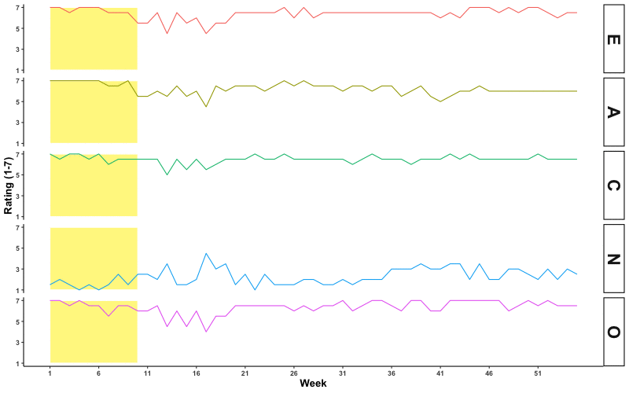
Idiographic Time Series
Notes:
Then, we can move the window across the times series and calculate the correlation within the windows

Slide 26
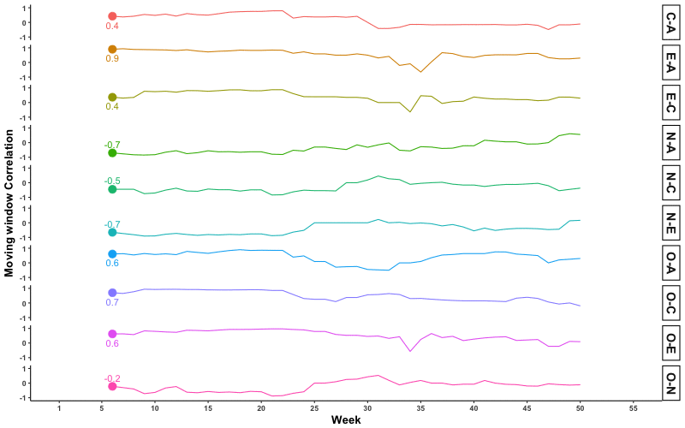
Moving Window Correlation Time Series
Notes:
Those correlations can also be represented as a time series of moving window correlations, where different lines represent the unique pairwise relationships among the personality measures.

Slide 27
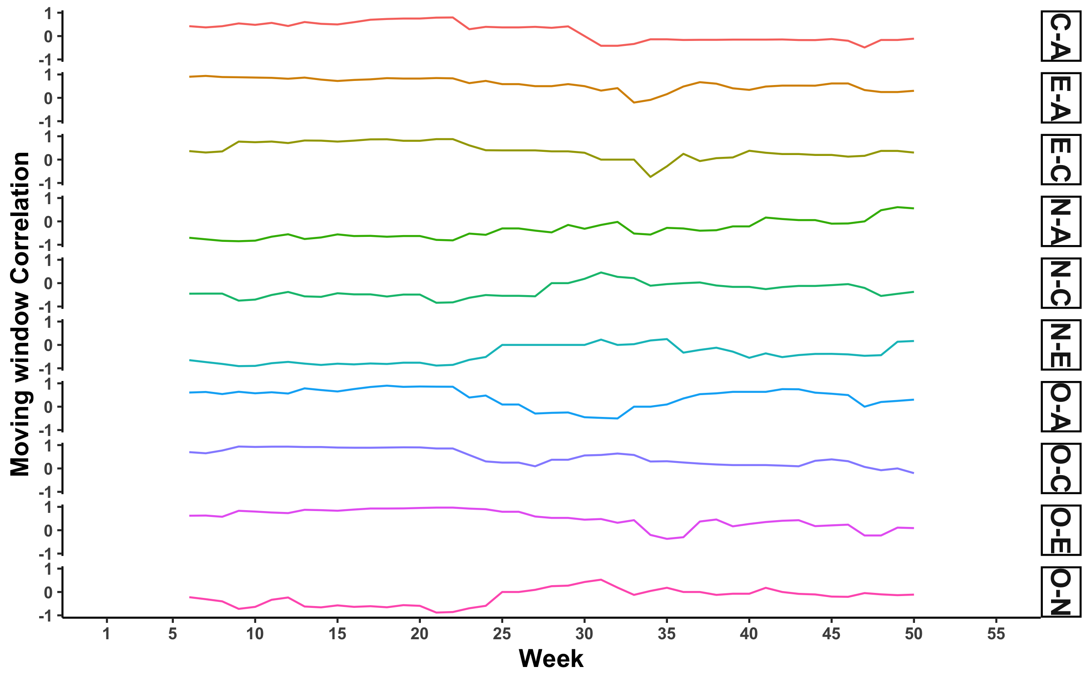
Moving Window Correlation Time Series
Notes:
Ultimately, it looks something like this

Slide 28
Phases: k = 0
Notes:
The logic here, is that if there are no changes in the correlations across the time series, then it can be considered a single unitary phase with no knows, so k=0

Slide 29
Correlations within a phase should be homogeneous
Notes:
Essentially, the goal of the procedure is to split the correlational time series into phases in which the correlations are as homogeneous, or similar, as possible

Slide 30
Phases: k = 0
Notes:
But how do we decide this

Slide 31
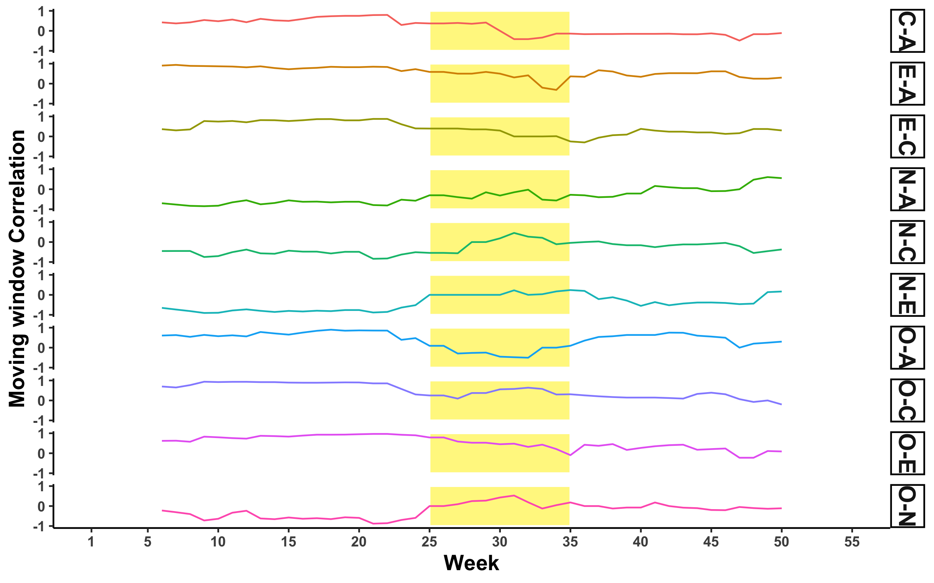
Notes:
In this tiem series, we see that the beginning of the times series is very consistent, but around 25 weeks in, we start notcing changes. But is there a real change point in this range, and if so where is it?

Slide 32
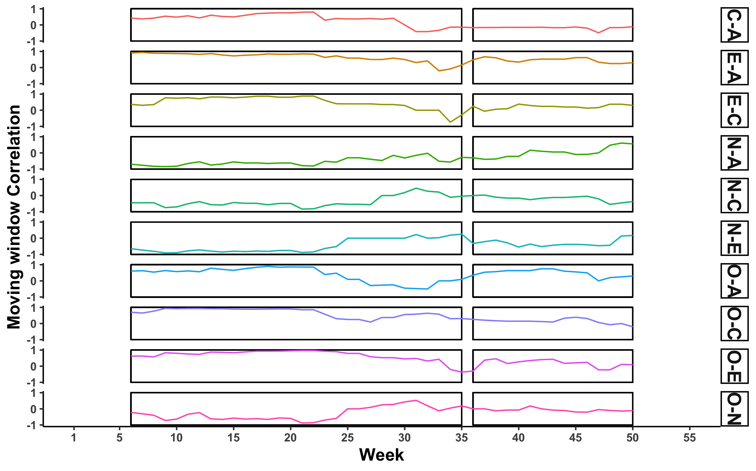
Phases: k = 1
Notes:
We arbitrarily decide it is at 35 weeks, and break the time series into two phases with one knot or k =1

Slide 33
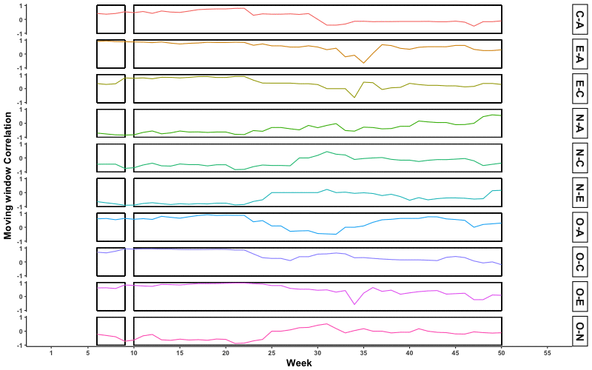
Phases: k = 1
Notes:
But even if we decide there is one knot, its location could theoretically be at any of these points in the time series.

Slide 34
Phases: k = 1
Notes:
So how do we decide?

Slide 35
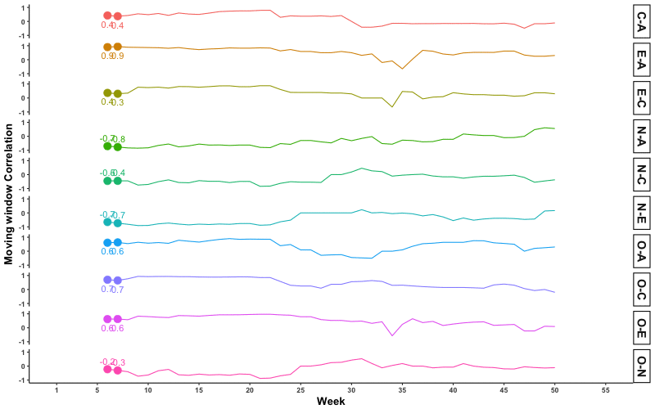
1
Moving Window Correlations
Gaussian Similarity for all
combinations of moving windows
2
3
Calculate average within-phase
Variance of Gaussian Similarity
Repeat steps 1 and 2 for 1000
permuted data sets
4
Perform the variance test
5
Perform the variance drop test
6
Declare significance if either the
variance or variance drop tests passes
7
Keep k of max drop and compare
it to the permuted data with k phases
8
Notes:
Not going to get into the details, but basically, the KCP procedure is going to leverage the gaussian similarity between the correlations of different windows to test whether the variance of those correlations between two points is greater than what we would expect if the time series was randomly ordered.

Slide 37
1
Moving Window Correlations
Gaussian Similarity between all
possible phases for different k
2
3
Calculate average within-phase
Variance of Gaussian Similarity
Repeat steps 1 and 2 for 1000
permuted data sets
4
Perform the variance test
5
Perform the variance drop test
6
Declare significance if either the
variance or variance drop tests passes
7
Keep k of minimum penalized
average within-phase variance
8
Notes:
Not going to get into the details, but basically, the KCP procedure is going to leverage the gaussian similarity between the correlations of different windows to test whether the variance of those correlations between two points is greater than what we would expect if the time series was randomly ordered.

Slide 38
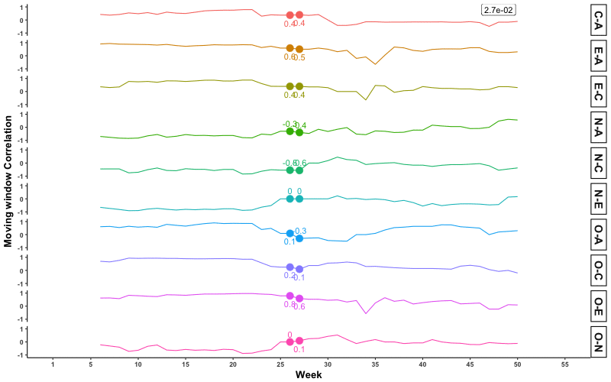
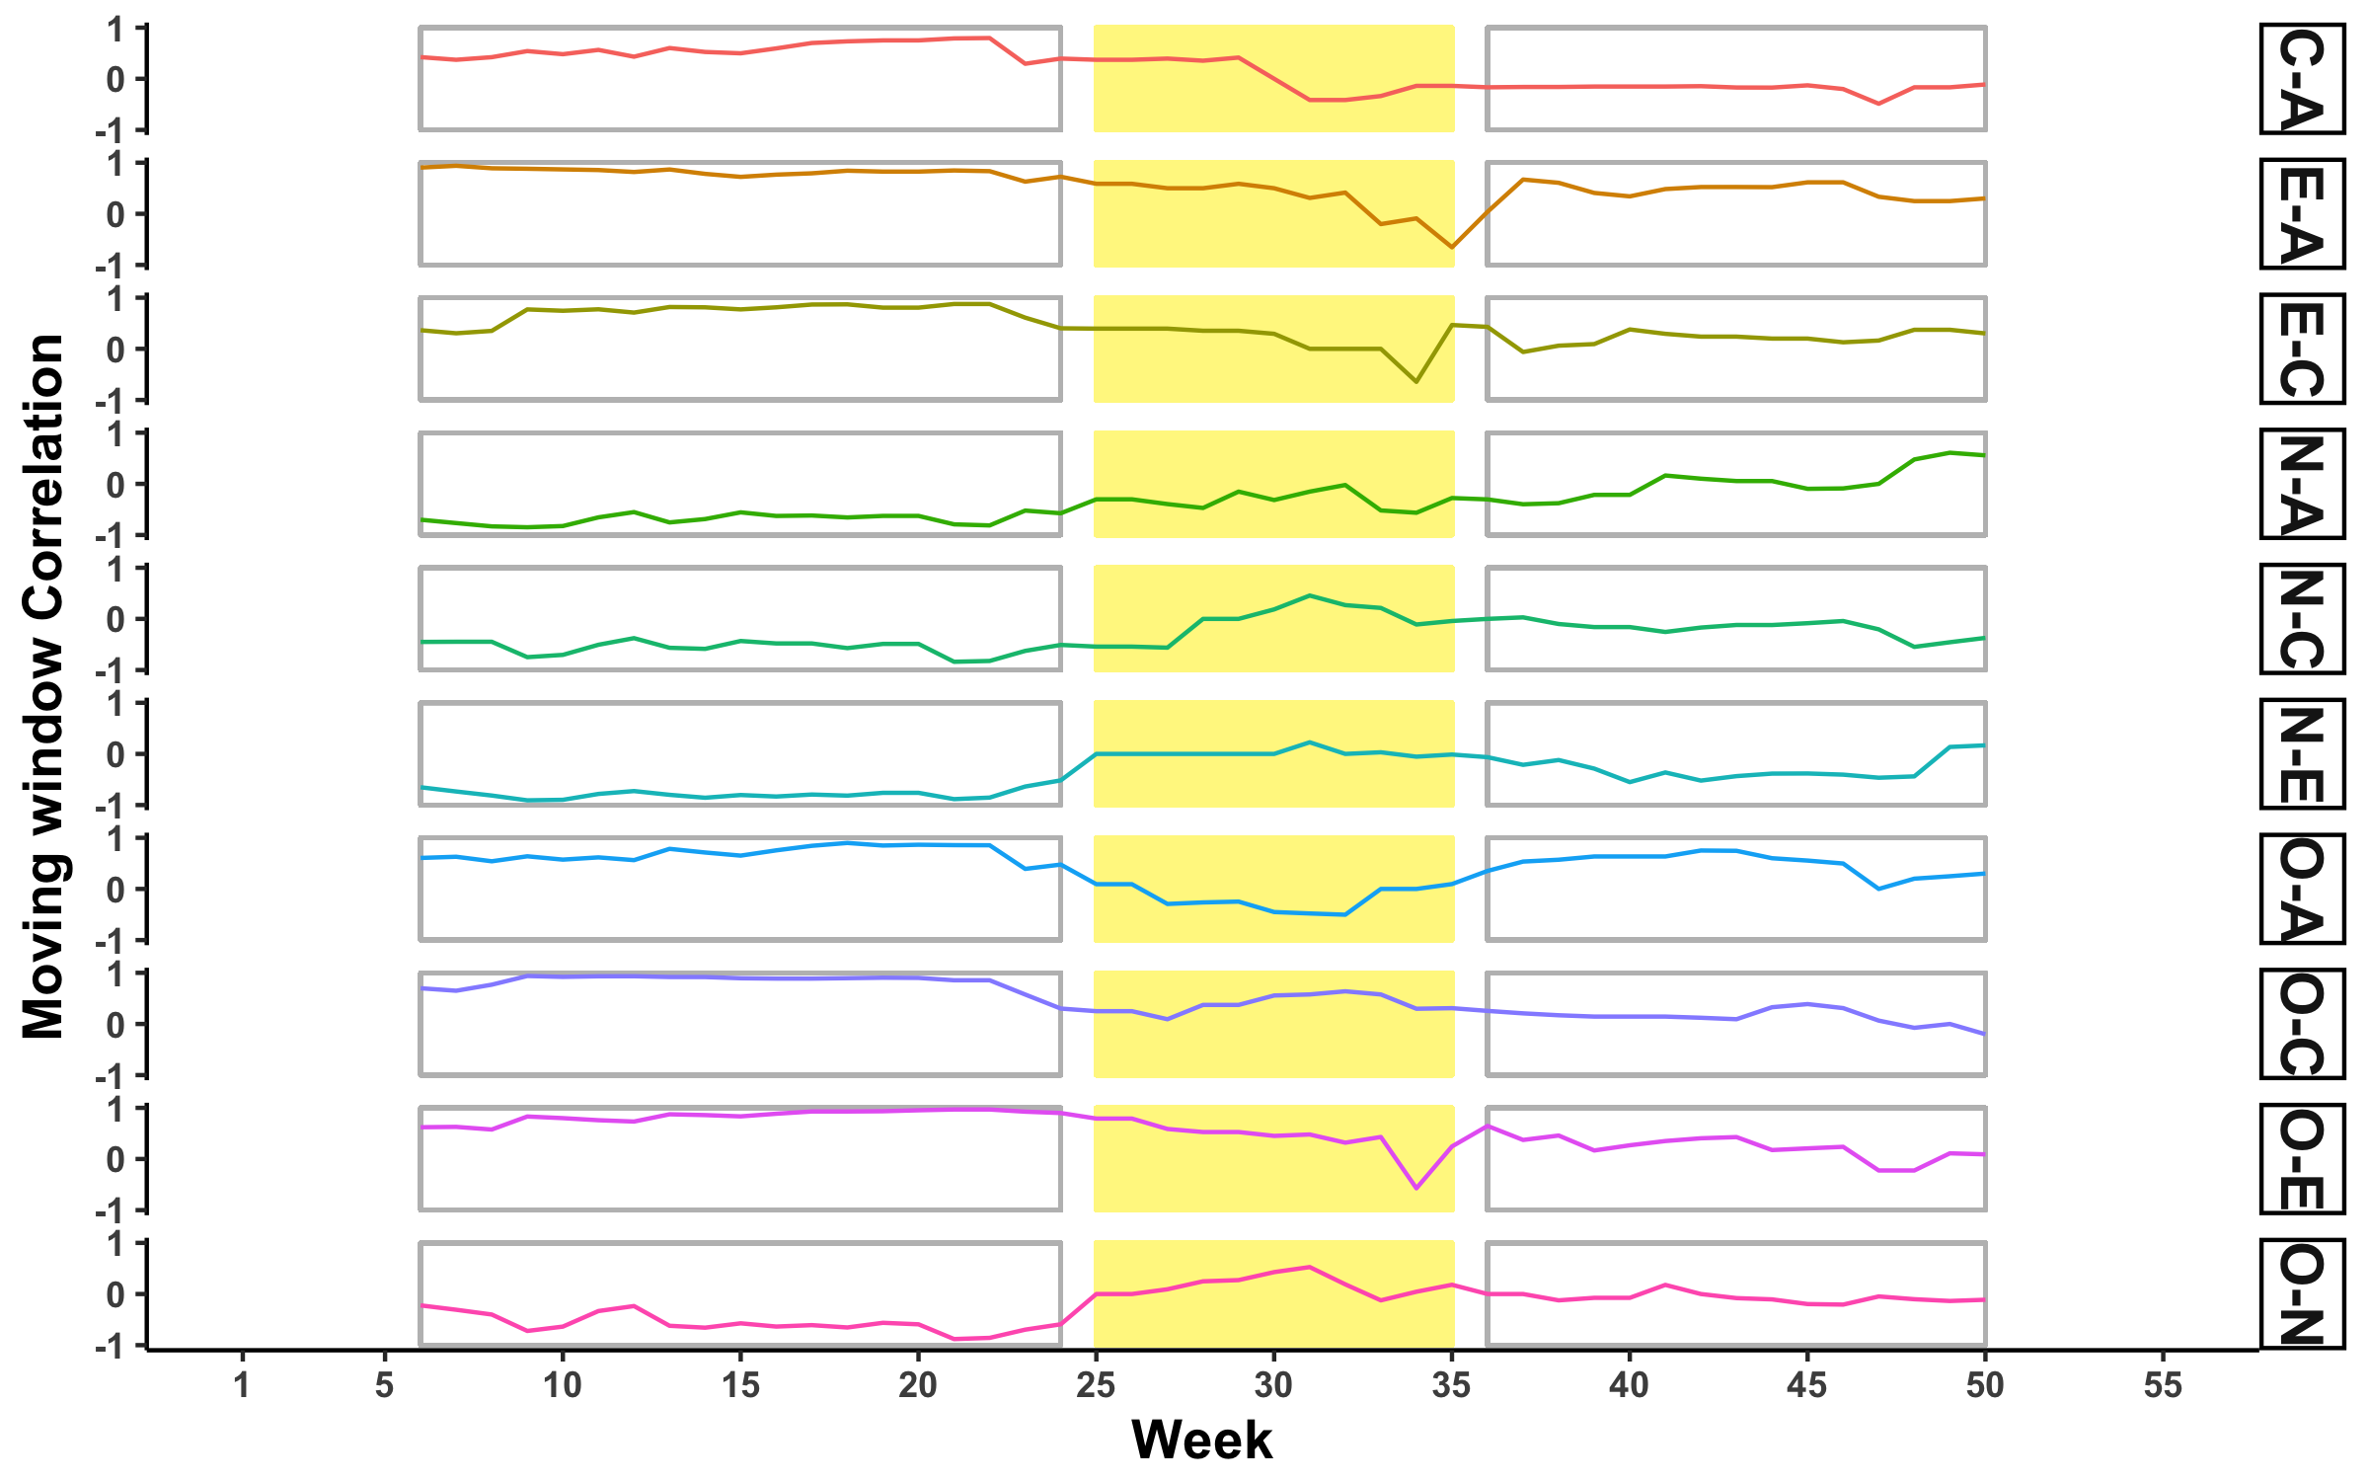

Slide 39
1
Moving Window Correlations
Gaussian Similarity between all
possible phases for different k
2
3
Calculate average within-phase
Variance of Gaussian Similarity
Repeat steps 1 and 2 for 1000
permuted data sets
4
Perform the variance test
5
Perform the variance drop test
6
Declare significance if either the
variance or variance drop tests passes
7
Keep k of minimum penalized
average within-phase variance
8
Notes:
This is where permutations come in.
Basically, if we shuffle the data in the time series, which should essentially remove any non-random patterns, we can look at the moving window correlations for the permuted data sets.

Slide 40
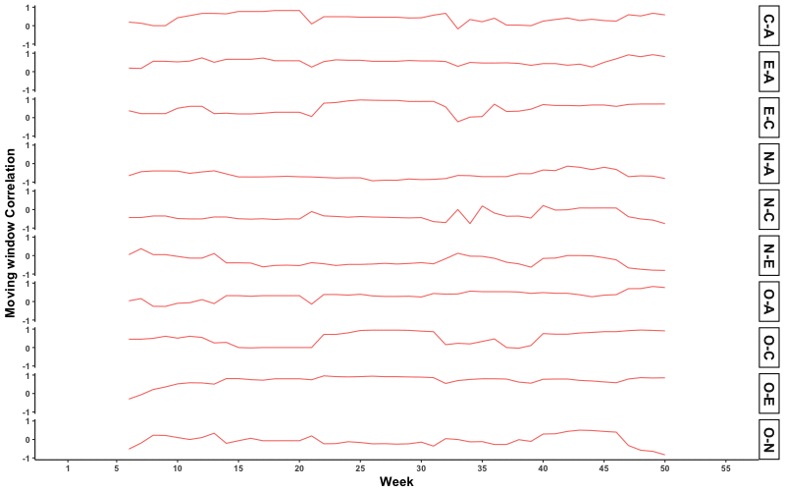

Slide 41
1
Moving Window Correlations
Gaussian Similarity between all
possible phases for different k
2
3
Calculate average within-phase
Variance of Gaussian Similarity
Repeat steps 1 and 2 for 1000
permuted data sets
4
Perform the variance test
5
Perform the variance drop test
6
Declare significance if either the
variance or variance drop tests passes
7
Keep k of minimum penalized
average within-phase variance
8
Notes:
Then we can compare the similarity of correlations within the permuted phases with the similiarity of the correlations in the raw phases. If there are changes, the similarity should be worse in raw data than in the permuted data, indicating reliable correlational change

Slide 42
Correlations within a phase should be homogeneous
*Compared to permuted time series
Notes:
In other words, the procedure helps us to break the time series into phases in which the correlations within the phases should be as similar or homogeneous as possible

Slide 43
1
Moving Window Correlations
Gaussian Similarity between all
possible phases for different k
2
3
Calculate average within-phase
Variance of Gaussian Similarity
Repeat steps 1 and 2 for 1000
permuted data sets
4
Perform the variance test
sum(var_{k=0,raw} > var_{k=0,perm})
5
# of permutations
Perform the variance drop test
6
Declare significance if either the
variance or variance drop tests passes
7
Keep k of minimum penalized
average within-phase variance
8
Notes:
Not going to get into the details, but basically, the KCP procedure is going to leverage the gaussian similarity between the correlations of different windows to test whether the variance of those correlations between two points is greater than what we would expect if the time series was randomly ordered.

Slide 44
1
Moving Window Correlations
Gaussian Similarity between all
possible phases for different k
2
3
Calculate average within-phase
Variance of Gaussian Similarity
Repeat steps 1 and 2 for 1000
permuted data sets
4
var_{drop} = var_{k} - var_{k-1}
Perform the variance test
5
sum(max(var_{d,raw}) > max(var_{d,perm}))
Perform the variance drop test
6
# of permutations
Declare significance if either the
variance or variance drop tests passes
7
Keep k of minimum penalized
average within-phase variance
8
Notes:
Not going to get into the details, but basically, the KCP procedure is going to leverage the gaussian similarity between the correlations of different windows to test whether the variance of those correlations between two points is greater than what we would expect if the time series was randomly ordered.

Slide 45
Slide showing possible windows for k again

Slide 46
1
Moving Window Correlations
Gaussian Similarity between all
possible phases for different k
2
3
Calculate average within-phase
Variance of Gaussian Similarity
Repeat steps 1 and 2 for 1000
permuted data sets
4
Perform the variance test
5
Perform the variance drop test
6
Declare significance if either the
variance or variance drop tests passes
7
Keep k of minimum penalized
average within-phase variance
8
Notes:
Not going to get into the details, but basically, the KCP procedure is going to leverage the gaussian similarity between the correlations of different windows to test whether the variance of those correlations between two points is greater than what we would expect if the time series was randomly ordered.

Slide 47
1
Moving Window Correlations
Gaussian Similarity between all
possible phases for different k
2
3
Calculate average within-phase
variance of Gaussian Similarity
Repeat steps 1 and 2 for 1000
permuted data sets
4
Perform the variance test
5
Perform the variance drop test
6
Declare significance if either the
variance or variance drop tests passes
7
Keep k of minimum penalized
average within-phase variance
8
Notes:
Not going to get into the details, but basically, the KCP procedure is going to leverage the gaussian similarity between the correlations of different windows to test whether the variance of those correlations between two points is greater than what we would expect if the time series was randomly ordered.

Slide 48
Results

Slide 49
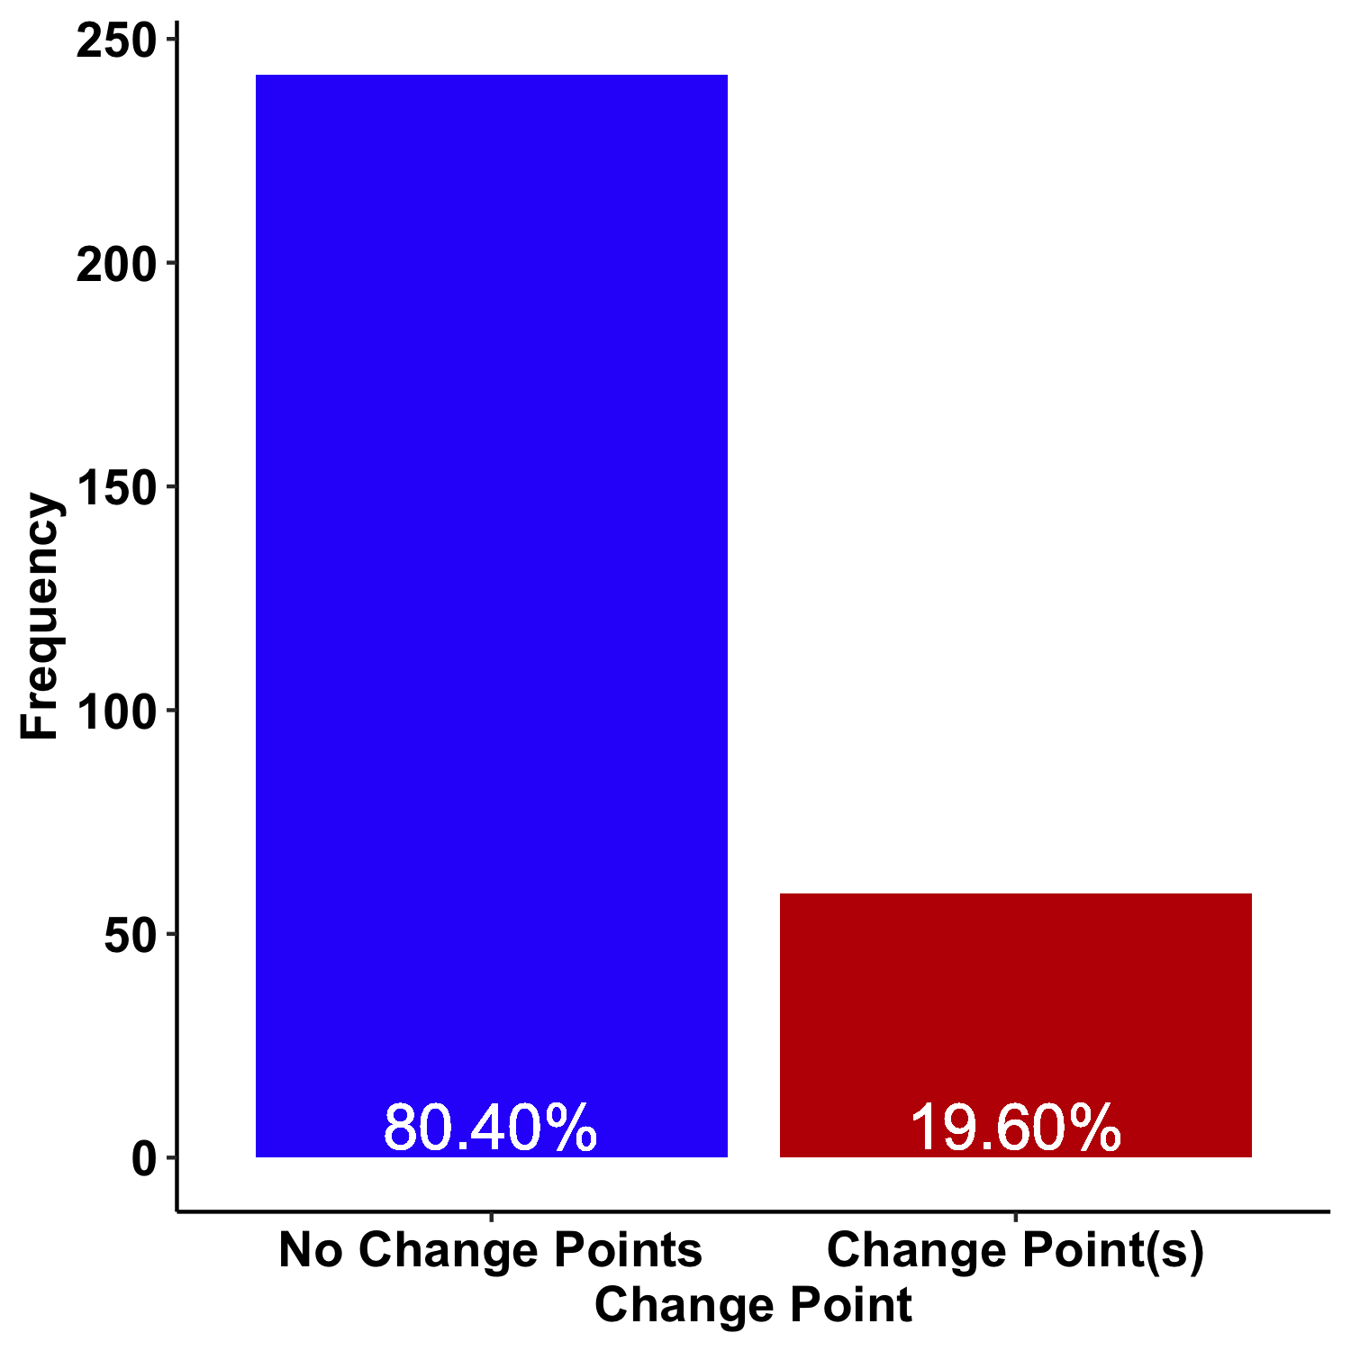
Did people show correlational changes?

Slide 50
Did people show correlational changes?

Slide 51
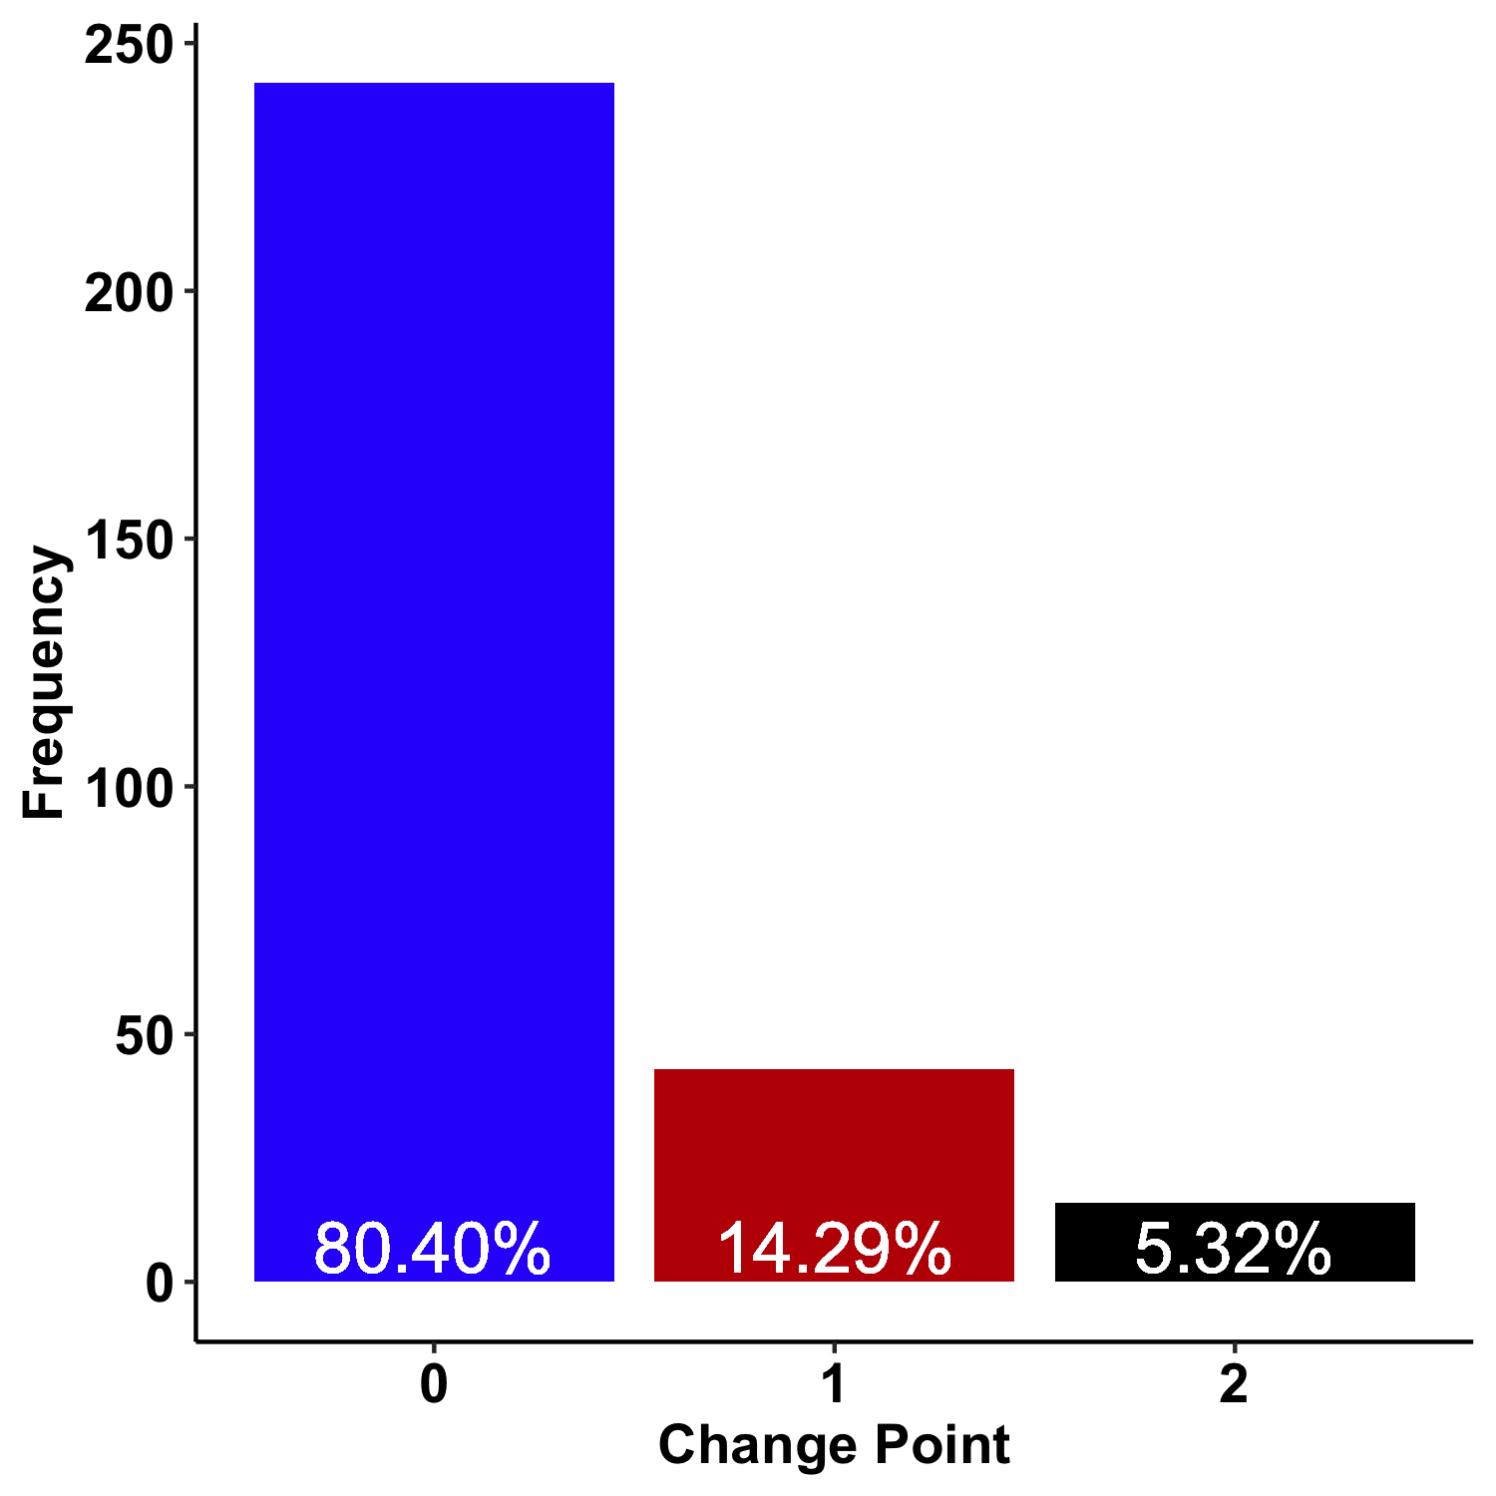
Did people show correlational changes?

Slide 52
Did people show correlational changes?

Slide 53
Where were there correlational changes?

Slide 54
Where were there correlational changes?

Slide 55
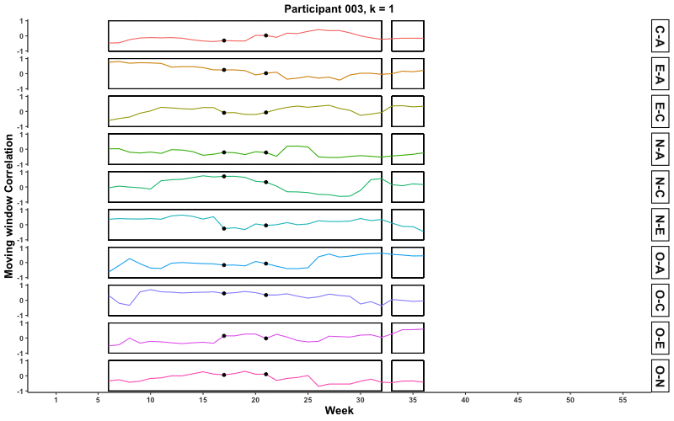
Where were there correlational changes?

Slide 56
Where were there correlational changes?

Slide 57
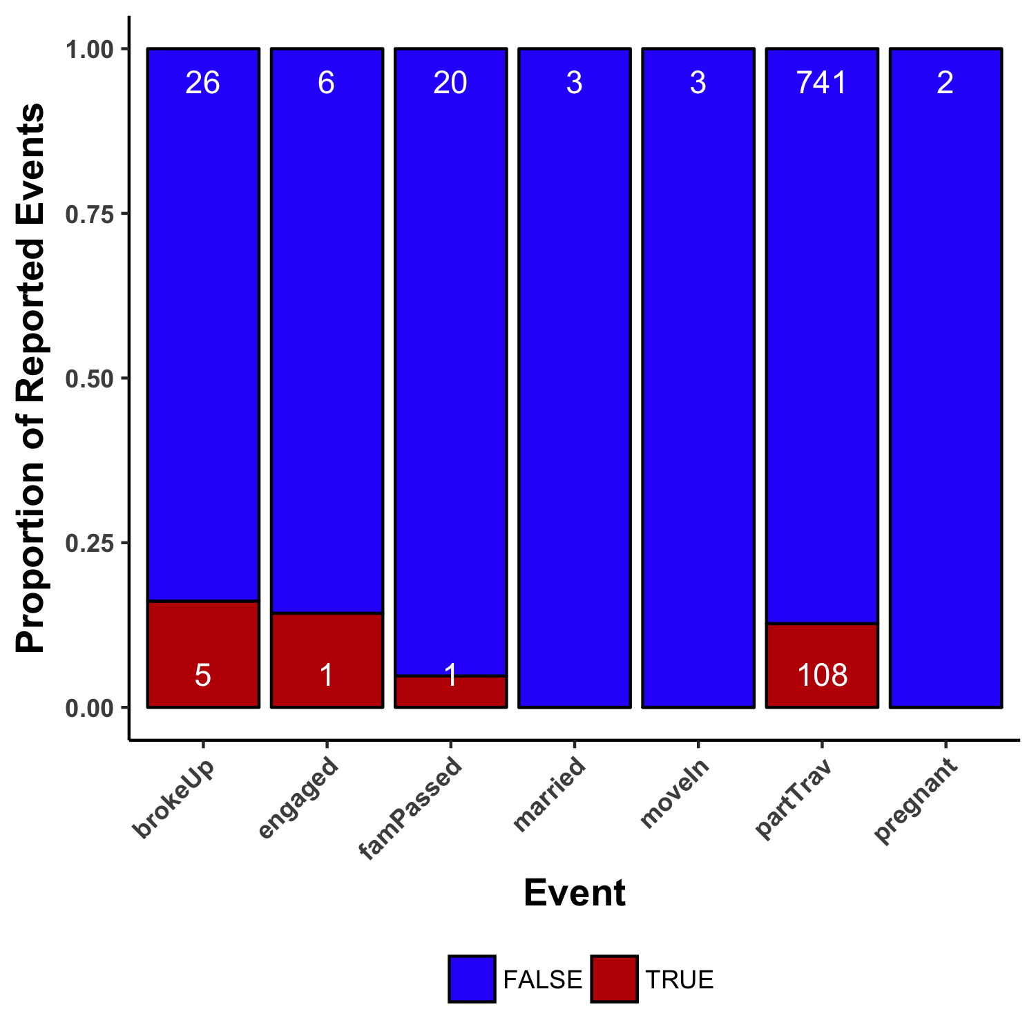
Did changes map onto events?

Slide 58
Did changes map onto events?

Slide 59
(Statistically) reliable correlational changes

Slide 60
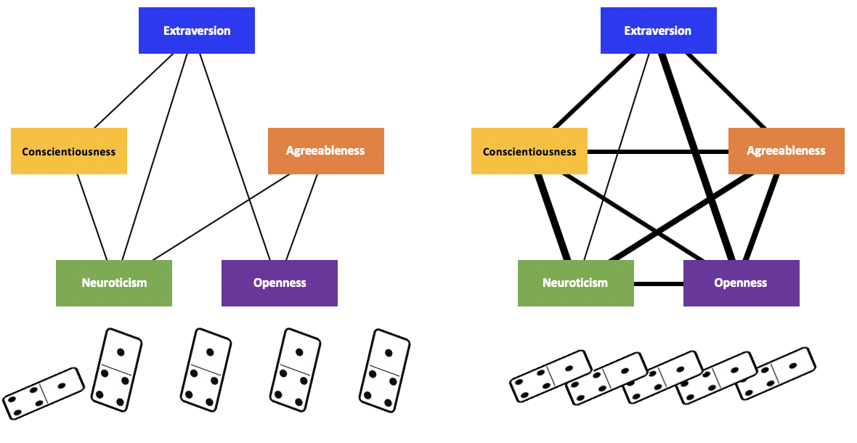
“Tipping Points”
Far from Transition
Close to Transition
Bonanno, 2004; van Leemput et al., 2014; Cramer et al., 2016; Cabrieto et al., 2018
Notes:
The advantage of looking for correlation changes is that they may uniquely suggest when psychological systems are close to change, or “tipping points.” When the correlations are weak and absent, perturbations to the system will have to be very large to impact it overall. However, when the system is densely connected, even small perturbations can have cascading effects and push the system to a new equilibr

Slide 61
(Statistically) reliable correlational changes
Person-level systems of personality
Notes:
Second, we clearly saw that for some people, these life events did not seem to be associated with correlational changes, but that for some people, they were, highlighting the importance of considering individual level dynamics

Slide 62
(Statistically) reliable correlational changes
Person-level systems of personality
Time scale of changes
Notes:
Third, we saw that these changes can occur on the order of weeks, rather than months or years, which highlights the importance of attempting to collect data at shorter intervals

Slide 63
(Statistically) reliable correlational changes
Person-level systems of personality
Time scale of changes
The murky case for life events
Notes:
Finally, despite the case that some individuals did show correlational changes near the time when they experienced life events, the evidence for life events impacting personality change and development remains elusive.

Slide 64

Questions?
Special Thanks to:
Josh Jackson
The PMaD Lab
Results:
pmdlab.wustl.edu/KCP_2.07.html
Data and Code:
github.com/emoriebeck/KCP
Slides:
pmdlab.wustl.edu/ Beck_SPSP_2019.pptx
Preregistration:
osf.io/mfn8w/

